Slide 1
Universities Rankings
How is the ranking done? What are the criteria? Are there different rankings?

Slide 2
Problem Statment
A. Which universities are ranked in the top 10 globally?
B. Which universities are ranked in the top 10 for employment outcomes?
C. What positions do universities in Saudi Arabia hold within the global
rankings?
D. Considering various factors such as employment rankings, research
rankings, and others, which has the most significant impact on a
university's overall ranking?
E. Is there a correlation between national and global university rankings, and
based on this information, can you recommend a country that appears to
have a high concentration of top-ranked universities?

Slide 3
Ranking References
Academic Ranking:
Shanghai Rankings
THE CENTER FOR WORLD UNIVERSITY RANKINGS
Impact Ranking:
Times Higher Education Rankings

Slide 4
TOP 10
Shanghai Ranking 2023
University Name | World Rank
Harvard University | 1
Stanford University | 2
Massachusetts Institute of Technology (MIT) | 3
University of Cambridge | 4
University of California, Berkeley | 5
Princeton University | 6
University of Oxford | 7
Columbia University | 8
California Institute of Technology | 9
University of Chicago | 10

Slide 5
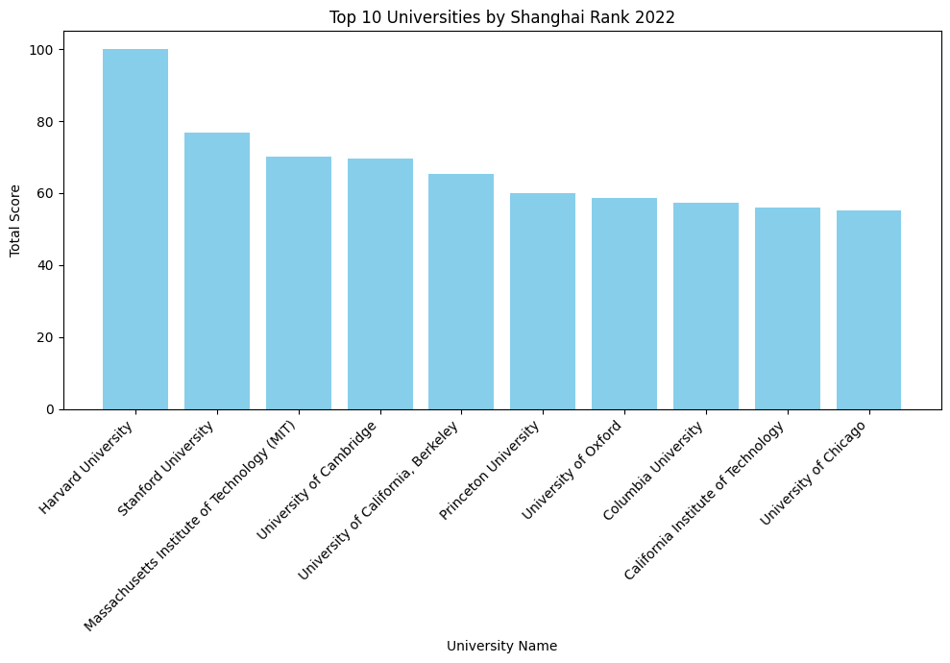
TOP 10
Shanghai Ranking 2022

Slide 6
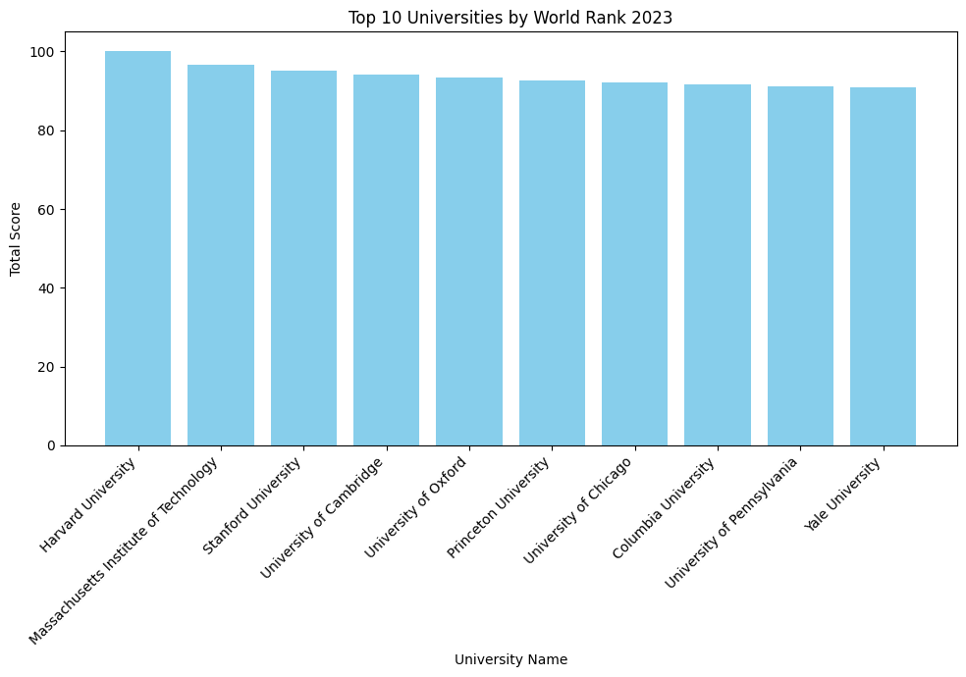
TOP 10
World Rank 2023

Slide 7
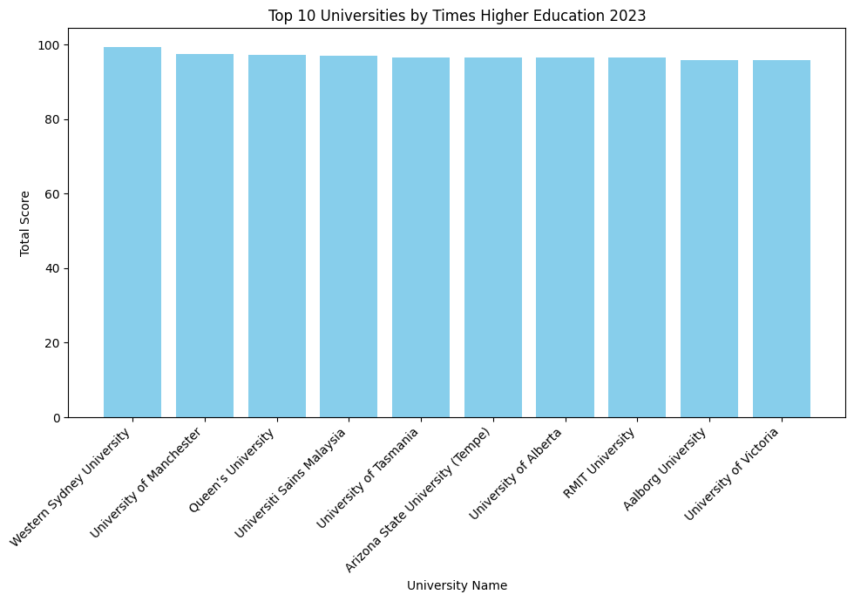
TOP 10
Times Higher Education 2023

Slide 8
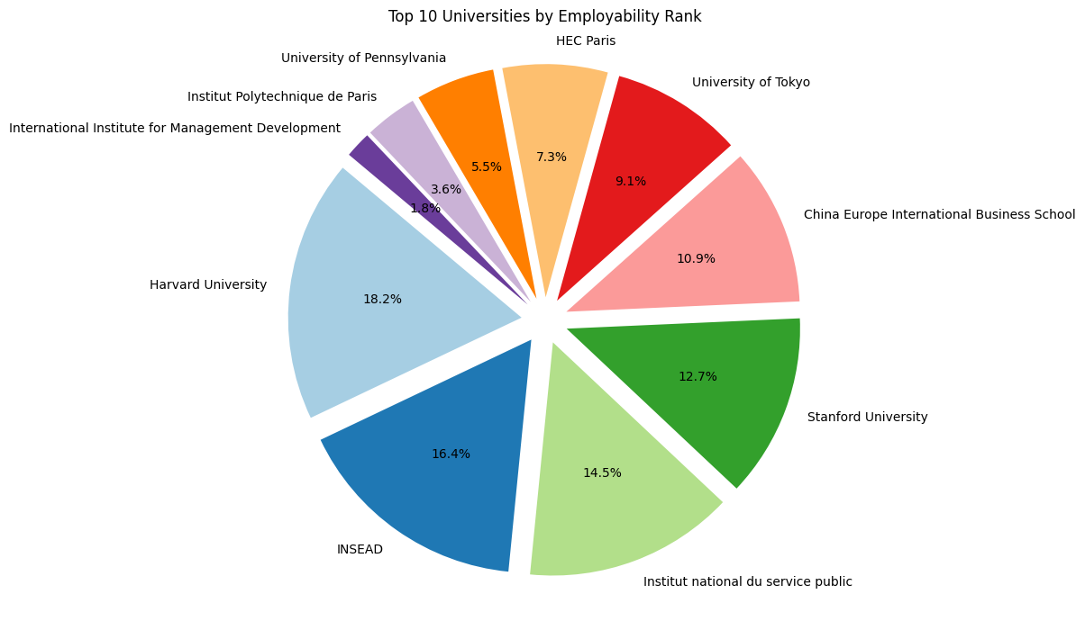
Employability Rank

Slide 9
Saudi Universities Ranking Shanghai Ranking 2023
Saudi Universities Ranking Times Higher Education 2023
Saudi Universities Ranking World Ranking 2023
University Name | World Rank
King Saud University | 101-150
King Abdulaziz University | 151-200
King Abdullah University of Science and Technology | 201-300
Taif University | 201-300
Princess Nourah bint Abdulrahman University | 301-400
King Fahd University of Petroleum & Minerals | 401-500
King Khalid University | 401-500
Prince Sattam Bin Abdulaziz University | 501-600
King Faisal University | 801-900
Umm Al-Qura University | 801-900
Al Jouf University | 901-1000
University Name | World Rank
King Abdullah University of Science and Technology | 101–200
King Faisal University | 101–200
Prince Mohammad Bin Fahd University | 101–200
AlMaarefa University | 201–300
Imam Abdulrahman Bin Faisal University | 201–300
Imam Mohammad Ibn Saud Islamic University | 201–300
King Fahd University of Petroleum and Minerals | 201–300
Prince Sultan University (PSU) | 301–400
King Khalid University | 401–600
Qassim University | 401–600
University Name | World Rank
King Abdulaziz University | 245
King Abdullah University of Science and Technology | 279
King Saud University | 352
King Fahd University of Petroleum and Minerals | 657
King Saud bin Abdulaziz University for Health Sciences | 1311
King Khalid University | 1447
Taif University | 1509
Imam Abdulrahman Bin Faisal University | 1547
Taibah University | 1586
Prince Sattam Bin Abdulaziz University | 1711

Slide 10
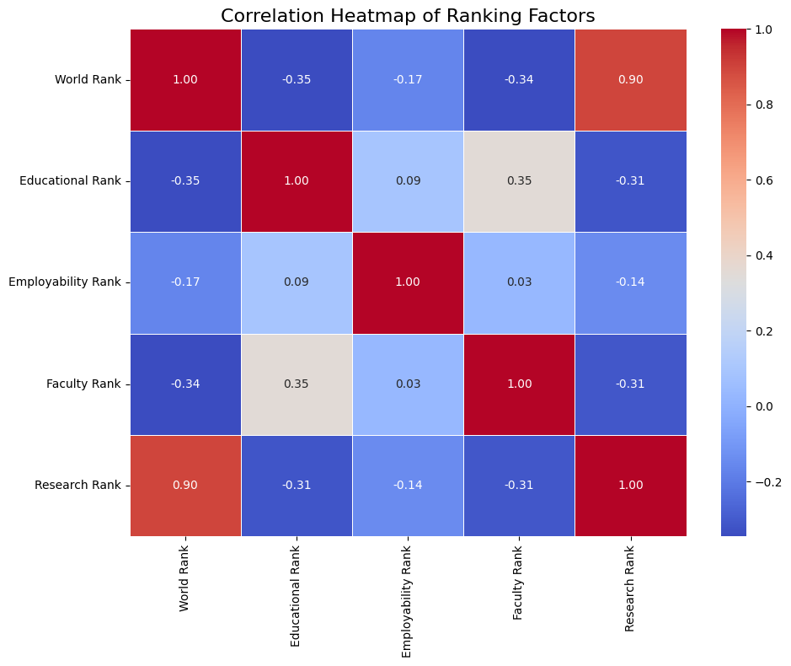
The Factors Impact

Slide 11
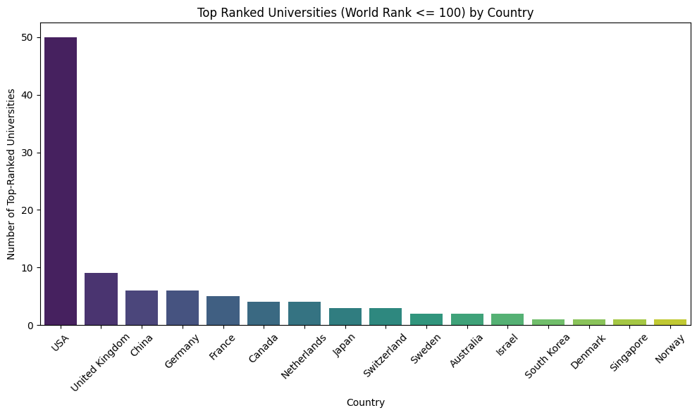
Correlation between global and national rank
Moderate National-World Rank Correlation (0.35): National rankings only moderately correlate with world rankings, indicating local and global criteria differ.

Slide 12
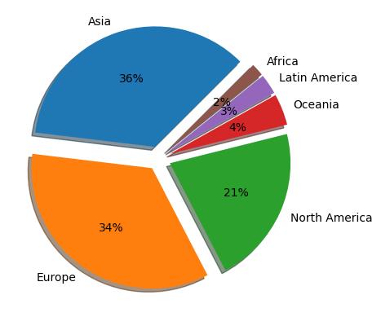
Global Distribution of Universities by Region (Shanghai 2023)

Slide 13
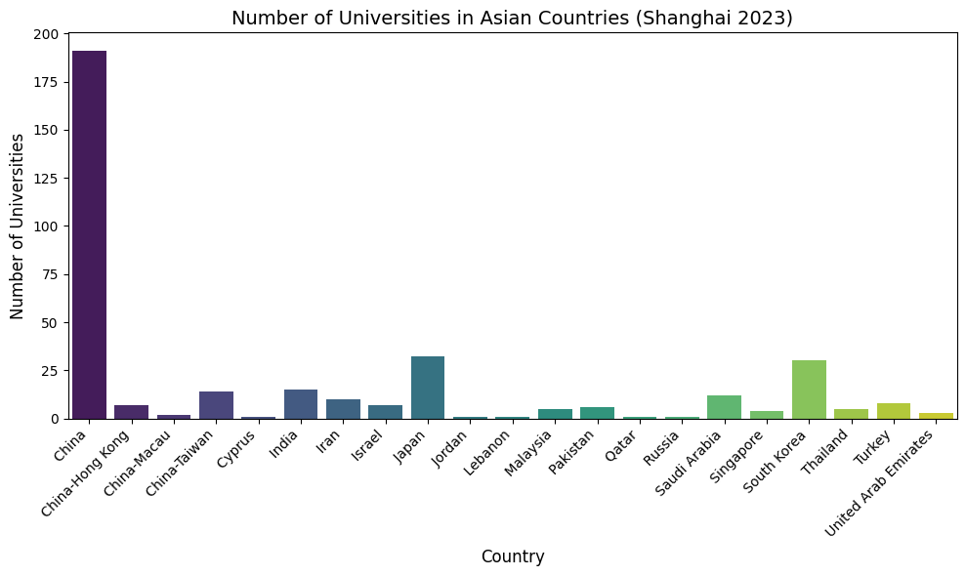
Global Distribution of Universities in Asia (Shanghai 2023)

Slide 14
Conclusions
Our analysis shows that U.S. universities dominate global rankings, with Harvard, Stanford, and MIT leading due to strong research output and faculty achievements. Employability rankings are more diverse, with top performers from France, Japan, and Australia. Saudi universities, led by King Abdulaziz University and KAUST, are rising in global rankings. Research rank has the strongest impact on the overall ranking, emphasizing its importance. China leads Asia in the number of ranked universities, reflecting rapid growth in higher education. These insights help guide students, researchers, and policymakers in academic decisions.

Slide 15
Thank you!
Ahmed Alhassar
Emtnan Alomireni
Naser Almanaa
Rahaf Alotaibi

